Slide 1
Set top box
By Ravi Kumar (09-Apr-2012)

Slide 2
Contents
Introduction to Set Top Box
Functionality
Software
IP and Vendors

Slide 3
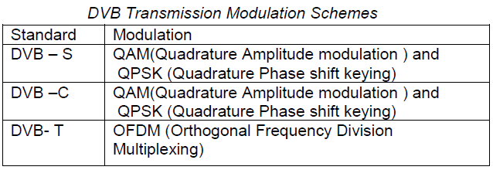
Introduction
Digital Video Broadcasting of TV signals can be done over three different mediums- Terrestrial, Cable and Satellite.
TV signals use DVB-C as the standard for transmission over the cable, DVB-T for terrestrial transmission and DVB-S for the satellite transmission.
The compression of TV signal can be done by MPEG-2 compression standard in all transmission types.
But the modulation scheme used in each case is different as below,

Slide 4
Set Top Box
Set Top Box (STB) is an instrument which converts the transmitted digital video signals to the data or the signals which can be displayed on the standard LCD, LED and Analogue TVs.
Front end in STB consists of Tuner and Demodulator.
The hardware configuration of all DVB-receivers is same except for demodulator, which is different for different DVB receivers as their transmission schemes are different.
This leads to the cost reduction in the set top boxes which can be used to receive all the three broadcasting signals.
Because of this there are two types of the concepts involved in deciding the architecture of the STB. They are Open Architecture and Interoperable.

Slide 5
Set Top Box
A STB can be considered to be a collection of a number of small functional blocks or modules, with each module performing a well defined function.
A module can be composed of pure hardware or pure software or some combination of the two.
Also each module is considered as Intellectual Property (IP).
In simple terms open architecture means all the Intellectual properties used in the developing of STB will be governed by the Fair Reasonable Non Discriminatory (FRND) terms.
Generally IP holders should accept the FRND terms set by recognized international bodies.
Interoperable means it should have the capability to receive signals from any of the DVB transmission type.

Slide 6
Set Top Box-Functionality
Major modules in the STB are Demodulator, Descrambler, CA Module, MPEG-2 Transport Stream De-multiplexer, MPEG-2 Decoder, CPU and Modem.
STB is tuned to select one of the appropriate frequency from the multiple frequencies present in the space.
Depending upon the transmission schemes the demodulator will be different.
Demodulator converts the RF signal into the original signal.
Output of the demodulator is MPEG-2 transport stream.

Slide 7
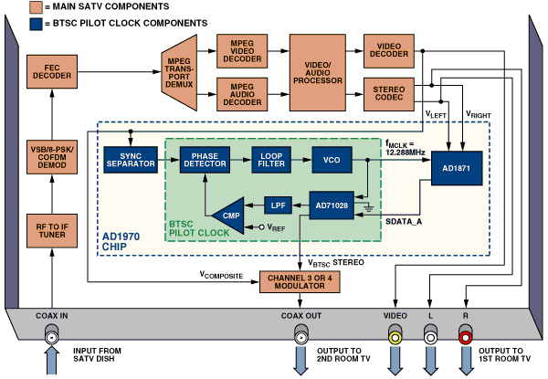
Set Top Box-Architecture

Slide 8
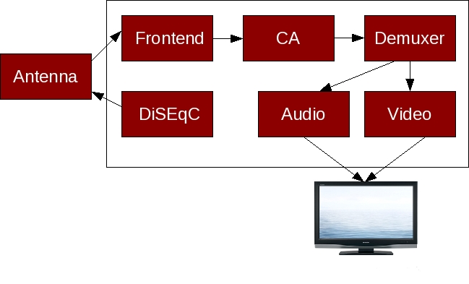
Set Top Box-Architecture

Slide 9
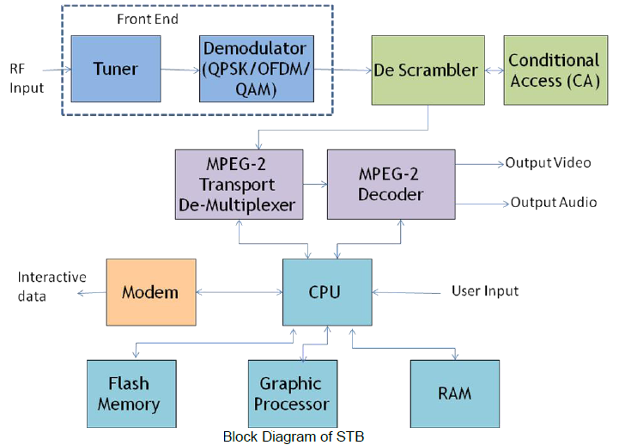
Set Top Box-Functionality

Slide 10
Set Top Box-Functionality
STB generally also contains some form of modem to allow it to send and receive interactive data.
Conventional telecommunication modems are typically used in satellite and terrestrial STBs while cable STBs generally has a cable modem.
DOCSIS cable modems use QAM demodulator for the downstream data while out-of-hand DAVIC cable modems use QPSK demodulator.
In both cases, a QPSK modulator is used to transmit the upstream data though DOCSIS also have a 16QAM mode.

Slide 11
Set Top Box-Functionality
Data Over Cable Service Interface Specification (DOCSIS) is an international telecommunications standard that permits the addition of high-speed data transfer to an existing cable TV (CATV) system.
Digital Audio Visual Council (DAVIC) is an international standard with the aim of promoting the success of interactive digital audio-visual applications and services by transmitting specifications of open interfaces and protocols that maximize interoperability, not only across geographical boundaries but also across diverse applications, services and industries.

Slide 12
Set Top Box-Functionality
In general, digital TV information in the MPEG-2 TS may be encrypted.
The MPEG de-multiplexer selects and decrypts the compressed audio and video for a particular program that the viewer wishes to watch, using decryption keys supplied by the Conditional Access Sub System (CASS).
The MPEG decoder then compresses the audio and video information for the selected program.
The Central Processing Unit (CPU) controls the whole operation and performs specific data manipulation function.

Slide 13
Set Top Box-Functionality
It generally uses a Real Time Operating System (RTOS) on top of a hardware abstraction layer for the management of the resources and processes of the STB directed by the higher level software.
It is thus obvious that, the front-end, which contains the tuner and the demodulator, will be different for the three transmission media.
Hence if a STB is to be made interoperable across all the three transmission media it should be fitted with switchable front ends.
When an MPEG-2 TS carries encrypted (or scrambled) services, the TS also carries two types of messages called EMM (Entitlement Management Message) and ECM (Entitlement Control Message).

Slide 14
Set Top Box-Functionality
An EMM carries a list of Pay TV services which the owner of that STB is entitled to view and also the date up to which he is entitled to receive them.
The ECM on the other hand carries a data element called control word (CW), which is used by the descrambler in the STB to descramble the picture and make it intelligible again.
Both these messages are carried in the TS in an ‘encrypted’ form.
Algorithms used for ECM/EMM encryption are not standardized for various reasons.
DVB has standardized the scrambling algorithm known as DVB Common Scrambling Algorithm (DVBCSA).

Slide 15
Set Top Box-Functionality
The various DVB CSA complaint CA systems available in the market use different ECM/EMM encryption algorithms.
Thus the security of a given CA system depends primarily on the efficiency of the algorithm used for ECM, EMM encryption.
Such algorithms are closely guarded secret.
The CA module in the STB contains the relevant ECM, EMM decryption algorithm.
Hence when the CA module is embedded inside a STB it can no longer be considered to have an “Open Architecture”.
Further such an STB will not be interoperable across different networks which use different CA systems.

Slide 16
Set Top Box-Functionality
The question is how to make a STB interoperable across different networks using different CA systems.
The answer is provided by DVB in the form of an international standard called DVB Common Interface (DVB CI).
The below fig. shows the improved version of the STB which can receive any type of broadcasting signal and give the video and audio output.

Slide 17
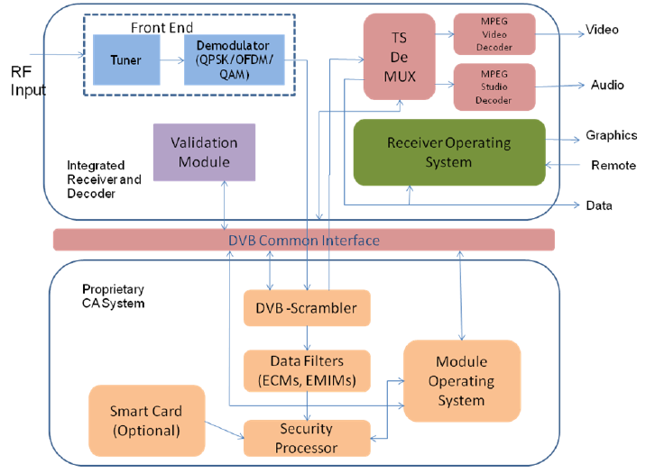
Set Top Box-Functionality

Slide 18
Set Top Box-Functionality
In this case the STB contains only those elements that are needed to receive clear broadcasts.
The CA system is contained in an external module, which communicates with the STB via DVB common interface connector provided on the STB.
Thus a STB fitted with the DVB CI connector is interoperable across different networks using different CA systems; all that a user has to do is to get the plug-in CA modules from different service providers.
In the US, cable labs refer to these cards as Point of Development (POD) modules.
In many cases tuner and demodulator are integrated as one part and TS de-multiplexer, descrambler, MPEG-2 decoder, CPU and CAM are integrated into one module.

Slide 19
Set Top Box-Software
Operating system in the STB talks with hardware present and manages their functions such as scheduling real time tasks, managing limited memory resources, etc.
STB OS is present in the “Kernel” layer, which is stored in ROM.
Once the STB is powered up, the kernel will be loaded first and remains in memory until the STB is powered down again.
Typically the kernel is responsible for managing memory resources, real time applications and high-speed data transmission.
It also supports multi threading and multi tasking which allows a STB to execute different sections of a program and different programs simultaneously.

Slide 20
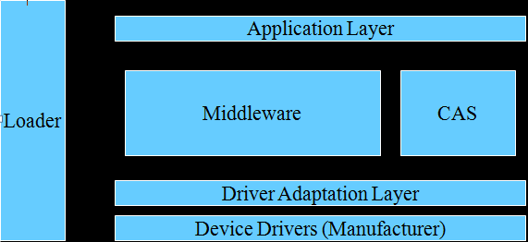
Set Top Box- Software Architecture

Slide 21
Set Top Box-Software
At present there is no standard STB OS.
Many broadcasters and consumer electronics companies are continuing to promote their own in-house solutions.
Some of the available solutions are: Power TV OS, Vx Works pSO System, Microware’s DAVID OS-9, Microsoft Windows CE etc.
In additional to the kernel, a STB needs a ‘loader’ to enable the TV operator to upgrade ‘resident applications’ or download ‘OS patches’ to STB.
A resident application is a program or a number of programs that are built into the memory of the STB.

Slide 22
Set Top Box-Software
STB also requires ‘drivers’ to control the various hardware devices.
Driver is a program that translates commands which are recognizable by the hardware devices.
To develop any application on the OS an Application Programme Interface (API) is required.
API and Middleware in this context can be used interchangeably.
There are broadly two types of applications can be run on STB.
They are Interactive and Enhanced.
In enhanced application no data is transferred in a bidirectional path. But in the interactive application data is exchanged in bidirectional path.

Slide 23
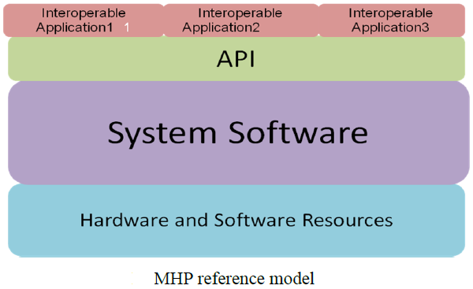
Set Top Box-Software
By considering both enhanced and interactive applications possible run on STB OS, STB will not be a interoperable.
So to make STB interoperable software architecture has been proposed by the DVB-project. This is called as Multimedia Home Standard.

Slide 24
Set Top Box-Software
API in MHP is based on Java, as Java is independent of platform.
MHP API is known as DVB-JAVA. Java is considered because of it is independent of the platform.
API and all interoperable applications will be developed in Java.
System software incorporates the Java virtual machine which in turn converts the java byte code into the machine understandable code.

Slide 25
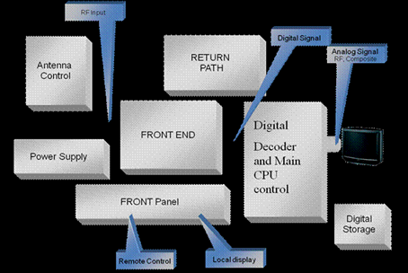
Set Top Box- Hardware Architecture

Slide 26
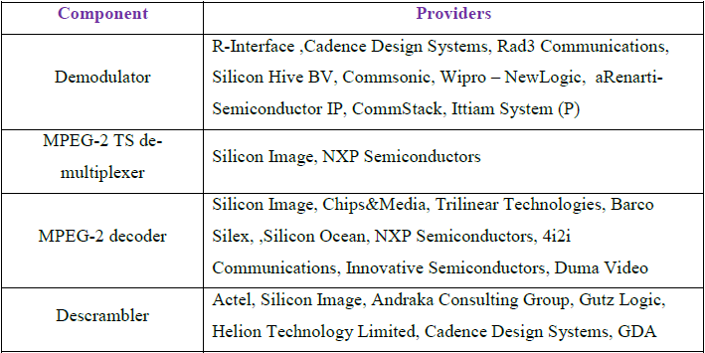

IP & Vendors
Hardware IPs/modules:

Slide 27
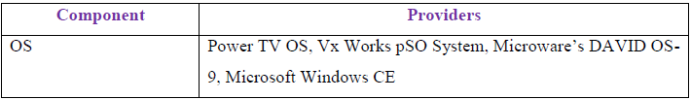
IP & Vendors
Software IPs:

Slide 28
Thank You

